Slide 1

Huazhong University of Science and Technology
The Department of Electronics and Information Engineering
Electronic Circuit Analysis and Design
Dr. Tianping Deng
Email: dengtp@hust.edu.cn

Slide 2
Contents
PART 1 SEMICONDUCTOR DEVICES AND BASIC APPLICATIONS
Chapter 1 Semiconductor Materials and Diodes
Chapter 2 Diode Circuits
Chapter 3 The Field-Effect Transistor
Chapter 4 Basic FET Amplifiers
Chapter 5 The Bipolar Junction Transistor
Chapter 6 Basic BJT Amplifiers
Chapter 7 Frequency Response
Chapter 8 Output Stages and Power Amplifiers
PART 2 ANALOG ELECTRONICS
Chapter 9 Ideal Operational Amplifiers and Op-Amp Circuits
Chapter 10 Integrated Circuit Biasing and Active Loads
Chapter 11 Differential and Multistage Amplifiers
Chapter 12 Feedback and Stability
Chapter 13 Operational Amplifier Circuits
Chapter 14 Nonideal Effects in Operational Amplifier Circuits
Chapter 15 Applications and Design of Integrated Circuits
Chapter 1 Semiconductor Materials and Diodes

Slide 3
Ch1. Semiconductor Materials and Diodes
1.1 Semiconductor Materials and Properties
1.2 The PN Junction
1.3 Diode Circuits DC Analysis and Models
1.4 Diode Circuits AC Equivalent Circuit
1.5 Other Diode Types
1.6 Design Application: Diode Thermometer
1.7 Summary

Slide 4
1.3 Diode Circuits DC Analysis and Models
1.3.1 Models
1.3.2 DC Analysis

Slide 5
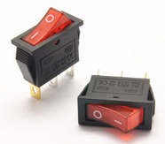
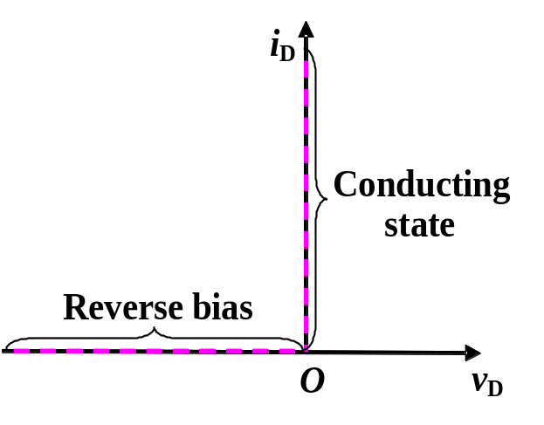
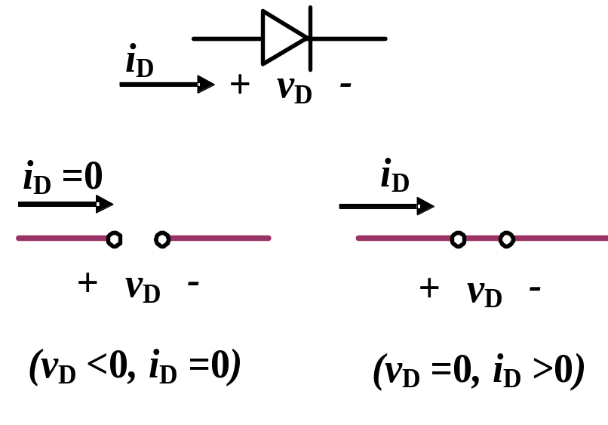
1.3 Diode Circuits_DC Analysis and Models
1.3.1 Models
Describing i-v characteristic, when analyzing circuit
1. Ideal model
(a) (b) (c)

Slide 6
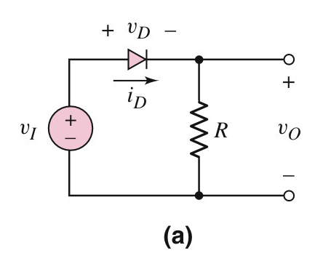
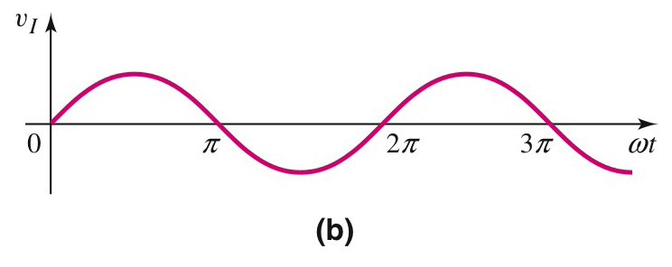

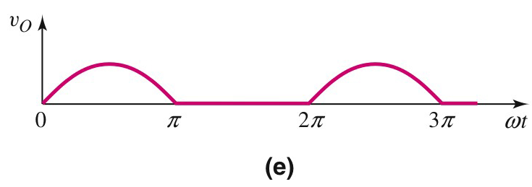


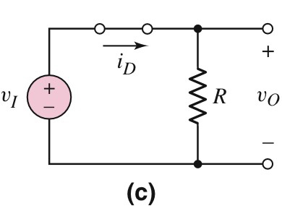
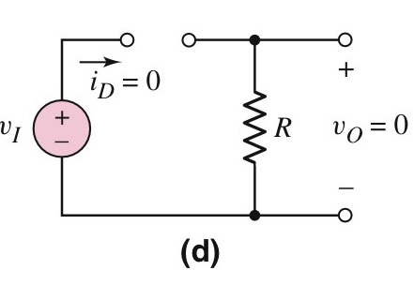
1.3 Diode Circuits_DC Analysis and Models
_{Half wave rectifier}
_{Simulation}

Slide 7
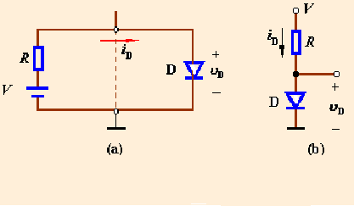
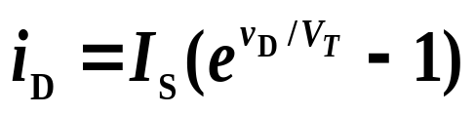
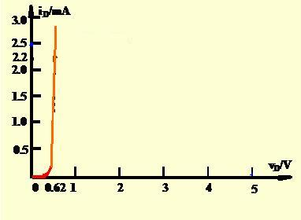

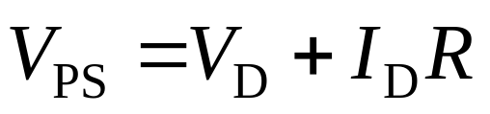
1.3.1 Graphical Analysis
PS
E.g.1.1 Determine the diode voltage and current for the circuit shown in figure, Assume
V_{PS}=5V , R=2kΩ
PS
(1) using the graphical analysis.
(a) Diode circuit
(b) Conventional
circuit
Sol: For diode
For R and V_{PS} branch
I_{DQ}
Find two special points (5V,0mA) and (0V, 2.5mA)
Intersection__quiescent point
or Q-point
V_{DQ}

Slide 8
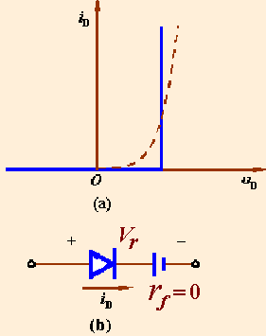
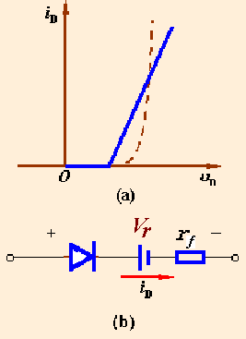
1.3.2 Piecewise model
Two linear approximations
Turn-on voltage
Forward diode resistance
Case 1
Case 2

Slide 9
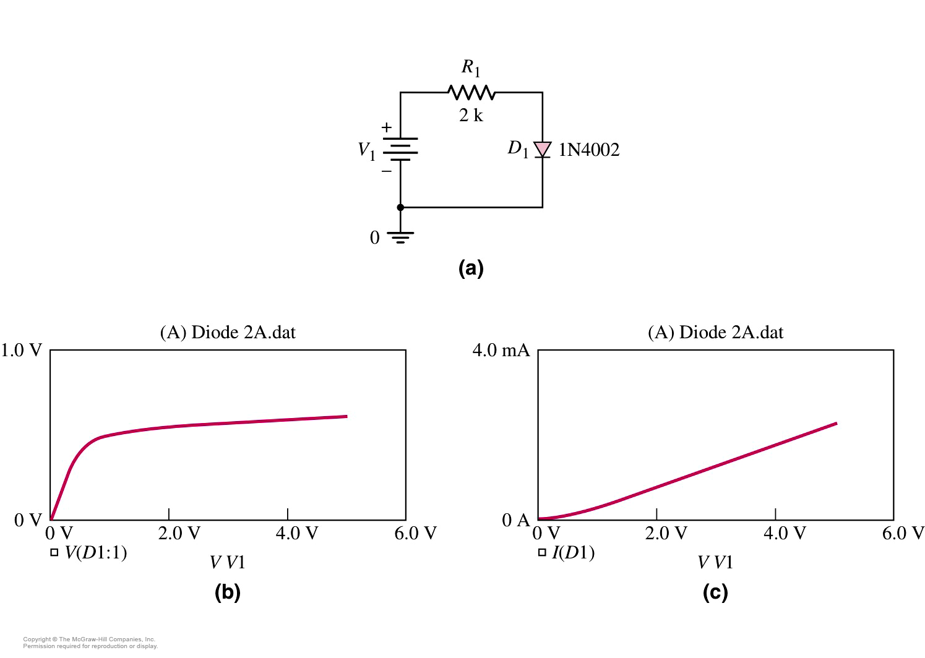
1.3.3 Computer Simulation
Circuit schematic
Diode voltage
Diode current

Slide 10
Questions
and
Answers

